Slide 1
Traffic volatility in context of predictability and flexibility and its impact on capacity and environment*
InterFAB Research Workshop
Zagreb, 18.4.2024
Dr. Matthias Whittome, FABEC
* Acknowledgments: Thanks to Thomas Standfuss, University of Dresden, Germany and Itziar Riuz Gauna & Ibon Galarraga, Metroeconomica, Spain

Slide 2
Outline
How can you measure predictability in ATM?
Indicator
Probability
Time horizon: hour, day, week, year, 5 years…
Size of airspace: sector, sector family, ACC, ANSP
Do inaccurate forecasts impact Capacity and Environment?
Delay: CRSTMP
Flight Efficency: KEA / KEP
What are the takeaways?
Statfor Forecasts 2002- 2020 and actual flights for Germany; Source: DFS

Slide 3
Motivation: tendency of „over-estimating“ traffic forecasts
Statfor Predictions for 2011 – 2018 for 38 European ANSPs, 5 year horizon

Slide 4
Accuracy of Forecasts (current metrics)
Traffic Forecasts are measured by two different metrics:
► Forecast is better than the actual of period before
► Actual Flights are between the low and high scenario in 50% of the cases
Statfor Predictions for 2011 – 2018 for 38 European ANSPs, 5 year horizon

Slide 5
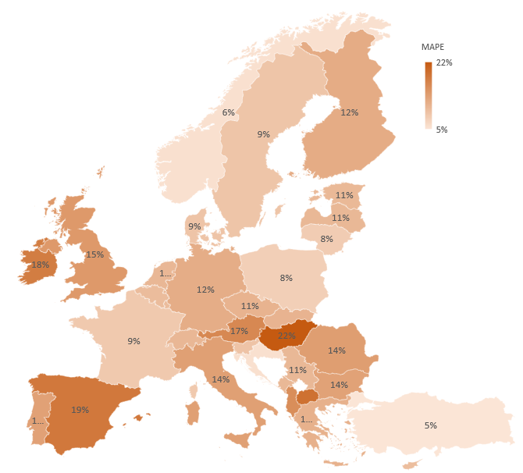
Accuracy of Forecasts (Proposal)
Mean Absolute Percentage Error = MAPE Score
MAPE informs on the deviation of predicted to actual flights in %.
► Which level of accuracy can be expected for the future?
► How likely is it that it will rain tomorrow?
$$MAPE=\frac{1}{n}\sum{\left|\frac{M_{A}−M_{P}}{M_{A}}\right|}$$
Statfor Forecasts, 5 year horizon, Predicted years 2011-2018

Slide 6
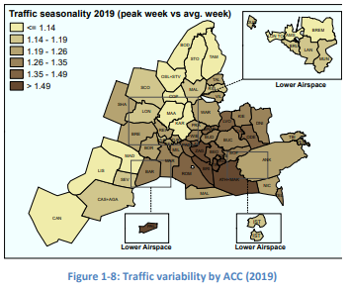
Traffic Volatility or Probability (current metric)
Traffic Predictions are for years, months, weeks, days, hours.
How likely will actual traffic deviate in a certain moment?
Current Metric: Peak week versus average week
(or peak month vs average month)
PRR 2019, page 8

Slide 7
Traffic Volatility or Probability (proposal)
$$σ=\sqrt{\frac{1}{n}\sum_{i=1}^{n}{{\left(x_{i}−μ\right)}^{2}}}$$
Standard deviation (σ): amount of variation expected to mean
Coefficient of variation (CV): ratio of σ to mean (suitable for comparing different units)
GINI coefficient: inequality among values of a distribution
$$CV= \frac{σ}{μ}=\frac{100}{μ}∙\sqrt{\frac{1}{n}\sum_{i=1}^{n}{{\left(x_{i}−μ\right)}^{2}}}$$
$$GINI=\frac{2∙\sum_{i=1}^{n}{i∙x_{i}}}{n∙\sum_{i=1}^{n}{x_{i}}}−\frac{n+1}{n}$$

Slide 8
Results σ for 2019 IFR flights based on monthly data

Slide 9
Disaggregation – Comparison of units with weekly data
GINI coefficient for 2019 used for
DFS
ACC Langen
Langen Sector Families
Findings:
Higher volatility, the smaller the unit and
more distributed (wider boxes and longer whiskers)
More outliers (dots)

Slide 10
Volatility (hourly) & Delay (daily) for 2015 - 2019

Slide 11
Increasing Volatility: ENAV 2015-2019 (Standard Deviation σ)

Slide 12
Relevance for ATCO Productivity & Delay
Regression Analysis with all European ANSPs:
ATCO Productivity as dependent variable
High MAPE Score (FQ) influences Productivity negatively and highly relevant (p-value < 0.1)
Volatility (Gini) impacts Productivity also negatively and highly relevant
Very high Model Quality (90%)
Similiar results for other years
Different regression test (years 2011-2018) for Delay: „under-estimations“ in traffic impact CRSTMP Delay positively – Model quality 45%.
Factor | Coefficient | Std. Error | t-quotient | p-value
const | -3,388 | 1,289 | -2,629 | 0,017 | **
SIZE (l) | 0,378 | 0,063 | 5,975 | 0,000 | ***
TIME (l) | 1,162 | 0,403 | 2,880 | 0,010 | ***
WEALTH (l) | -0,414 | 0,152 | -2,716 | 0,014 | **
OVER | 0,508 | 0,141 | 3,592 | 0,002 | ***
DOM | -2,036 | 0,507 | -4,016 | 0,001 | ***
GINI | -4,145 | 0,665 | -6,230 | 0,000 | ***
FQ | -0,142 | 0,081 | -1,746 | 0,097 | *
CI | -0,055 | 0,050 | -1,105 | 0,283
NONA | -0,547 | 0,305 | -1,794 | 0,089 | *
COSTS | 0,003 | 0,001 | 3,107 | 0,006 | ***
OCEAN | 0,187 | 0,075 | 2,489 | 0,022 | **
DELATM | -0,127 | 0,060 | -2,119 | 0,047 | **
AIRP | 0,668 | 0,137 | 4,866 | 0,000 | ***
JSC | 0,149 | 0,065 | 2,296 | 0,033 | **
STATE | -0,118 | 0,055 | -2,147 | 0,045 | **
Density | 0,034 | 0,012 | 2,789 | 0,012 | **
HI | 0,915 | 0,315 | 2,907 | 0,009 | ***
R² |  | 0,946
Adjusted R² |  | 0,897
Akaike |  | -47,779
Log-Likelihood |  | 41,890
Year: 2016 (Example)

Slide 13
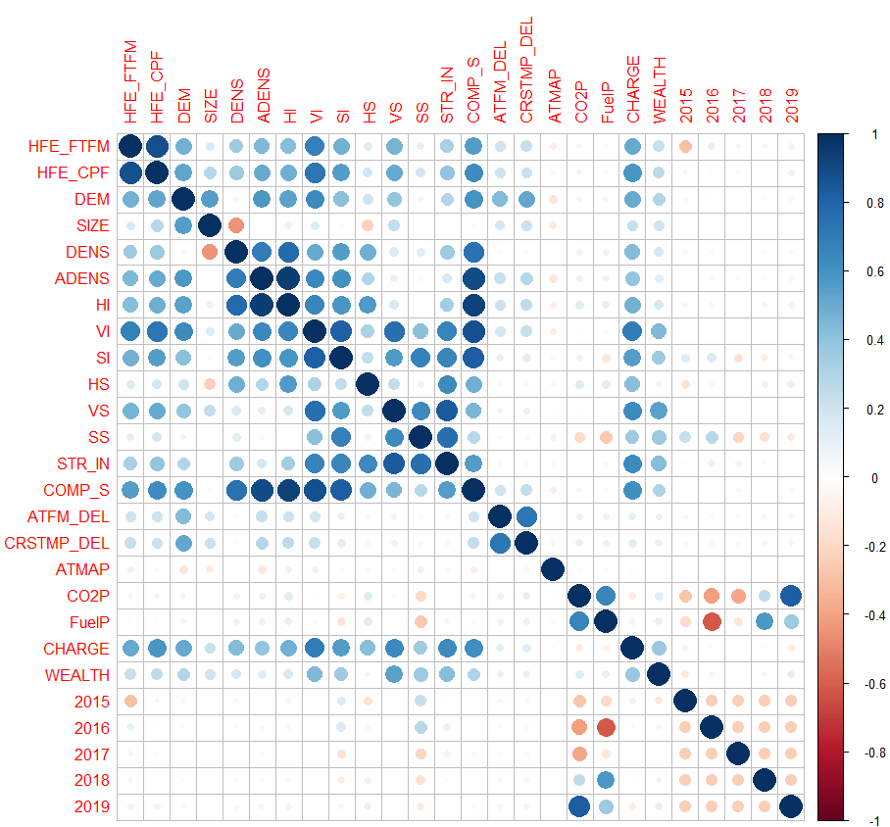
Relevance for Environment
Regression Model for all 46 European ANSPs (2015-2019):
Overall Model Quality: KEA 25% and KEP 19%.
KEP |  | KEA
Factor | Impact | Factor | Impact
Demand | 46 | Demand | 46
Weather (ATMAP) | 40 | Weather (ATMAP) | 44
CO2 Price | 34 | Fuel Price | 27
Fuel Price | 21 | ATFM Delay | 20
ATFM Delay | 15 | CO2 Price | 16
ATC Charges | 5 | ATC Charges | 15
Correlation between Factors

Slide 14
Conclusion
Accuracy of Traffic Forecast (MAPE) and Traffic Volatility (σ , CV and GINI) can be measured
Regression Analysis suitable to test relevance of indicators and their impact
Both are highly relevant for ATCO Productivity and CRSTMP Delay and they impact environmental KPIs (KEA and KEP)
Interdependency of KPAs can be detected and used for prediction

